Slide 1
ASD Mobile Interface - Kickoff
2016, UZH
A. Hueni (UZH)

Slide 2
Agenda
Einführung der Remote Sensing Laboratories (10’)
Einführung zum Einsatz von Spectral Ground Data für Luft und Weltraum-gestützte Sensor und Produkt Validation (10’)
Recap: Ziel der Arbeit
Praktische Demonstration eines Spectrometers (30’)

Slide 3
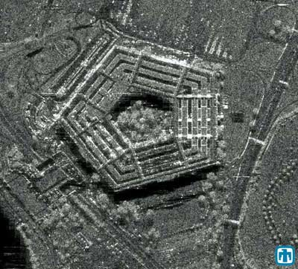
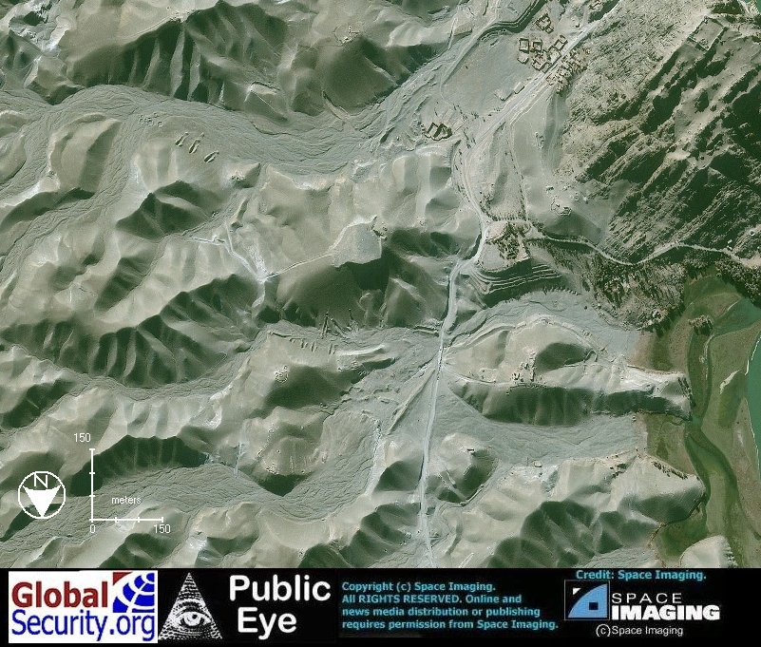
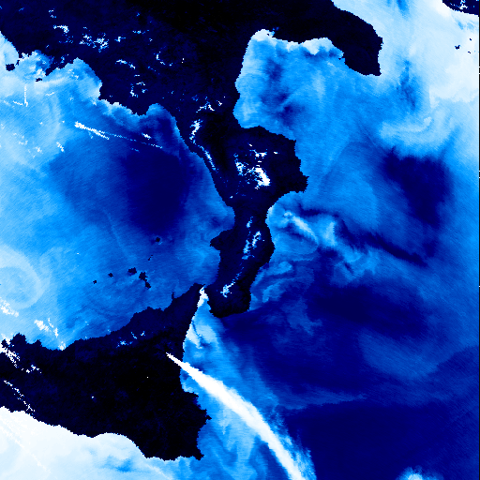
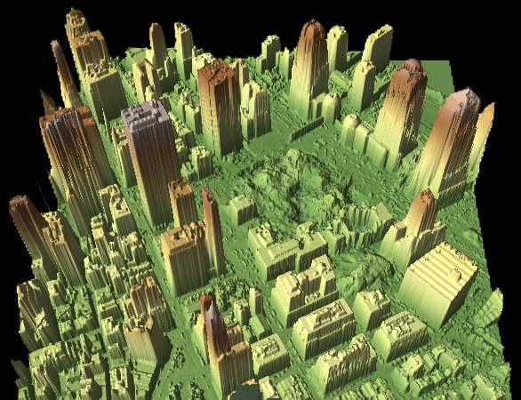
Sensors
Active
Passive
SAR
(Synthetic Aperture Radar)
LIDAR
VIS-NIR-SWIR
TIR
+ day & night & all weather
+ speed measurement possible
processing difficult
interpretation difficult
only 1 layer (black/white)
+ day & night
+ high precision
weather dependent
time intensive
+ > 1 colour layer
+ easy interpretation
weather dependent
day only
+ > 1 colour layer
+ day & night
- temperature extraction difficult
weather dependent
The Pentagon
www.thespacereview.com/article/790/1
World Trade Centre: Ground zero
http://imaging.geocomm.com/gallery/ wtc-lidar092701-overview.jpg
www.globalsecurity.org/military/world/afghanistan/darunta.htm
Mt Etna eruption
http://www.atsr.rl.ac.uk/images/sample/atsr-2/index.shtml

Slide 4

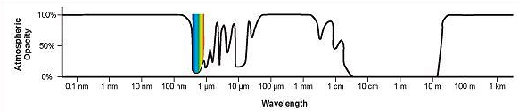
Electromagnetic waves and the atmosphere
VIS-NIR-SWIR
Radar
(Microwaves)
TIR (Thermal)

Slide 5
Spectroradiometry

Slide 6
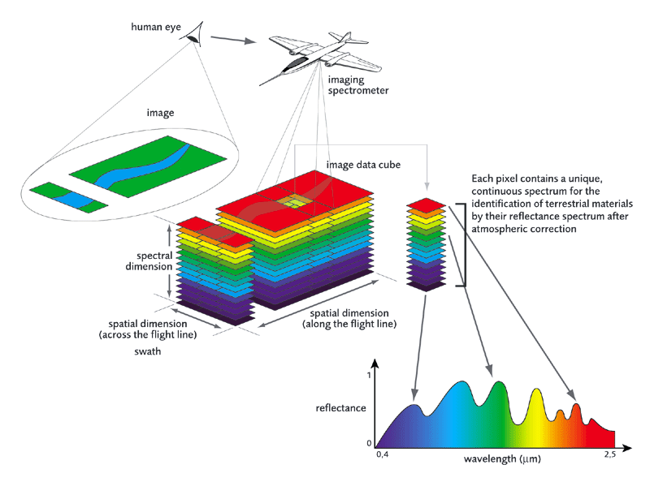
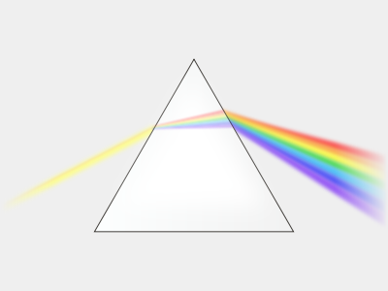
Imaging Spectrometers
Visible Light:
400 – 700 nm
APEX:
380 – 2500 nm
Diffraction of light by prism
Source: www.apex-esa.org

Slide 7
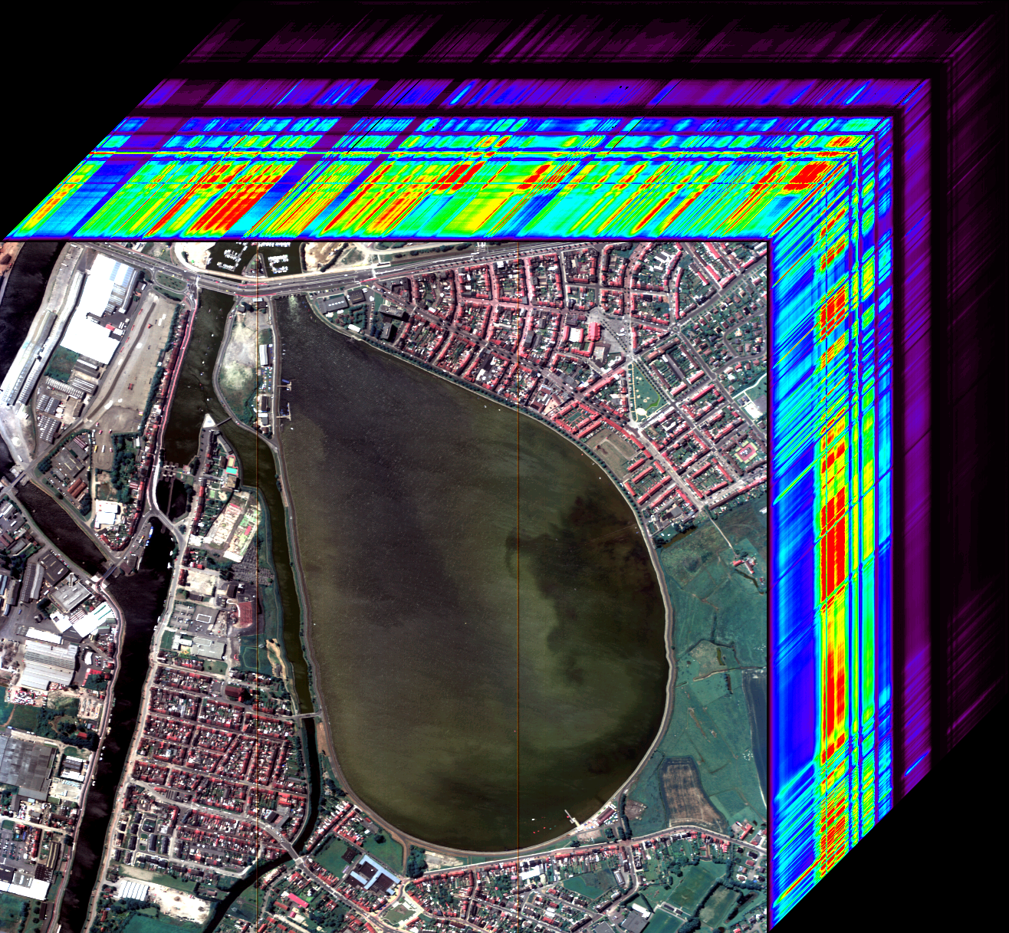
Image Cube Example
Image source: APEX Airborne Prism Experiment, 2009, Belgian Coast, processed by RSL, University of Zurich

Slide 8
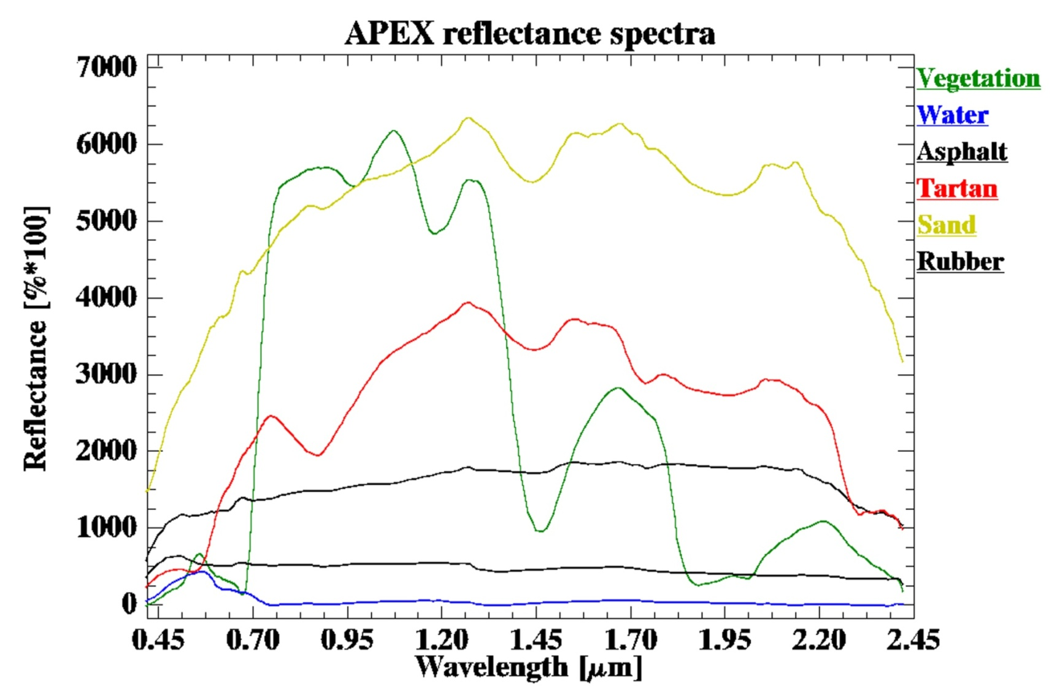
Spectral Analysis Basics
Assumption: Each material has a unique spectral signature, enabling its identification.

Slide 9
Product Validation / Calibration

Slide 10
Product Validation / Calibration

Slide 11
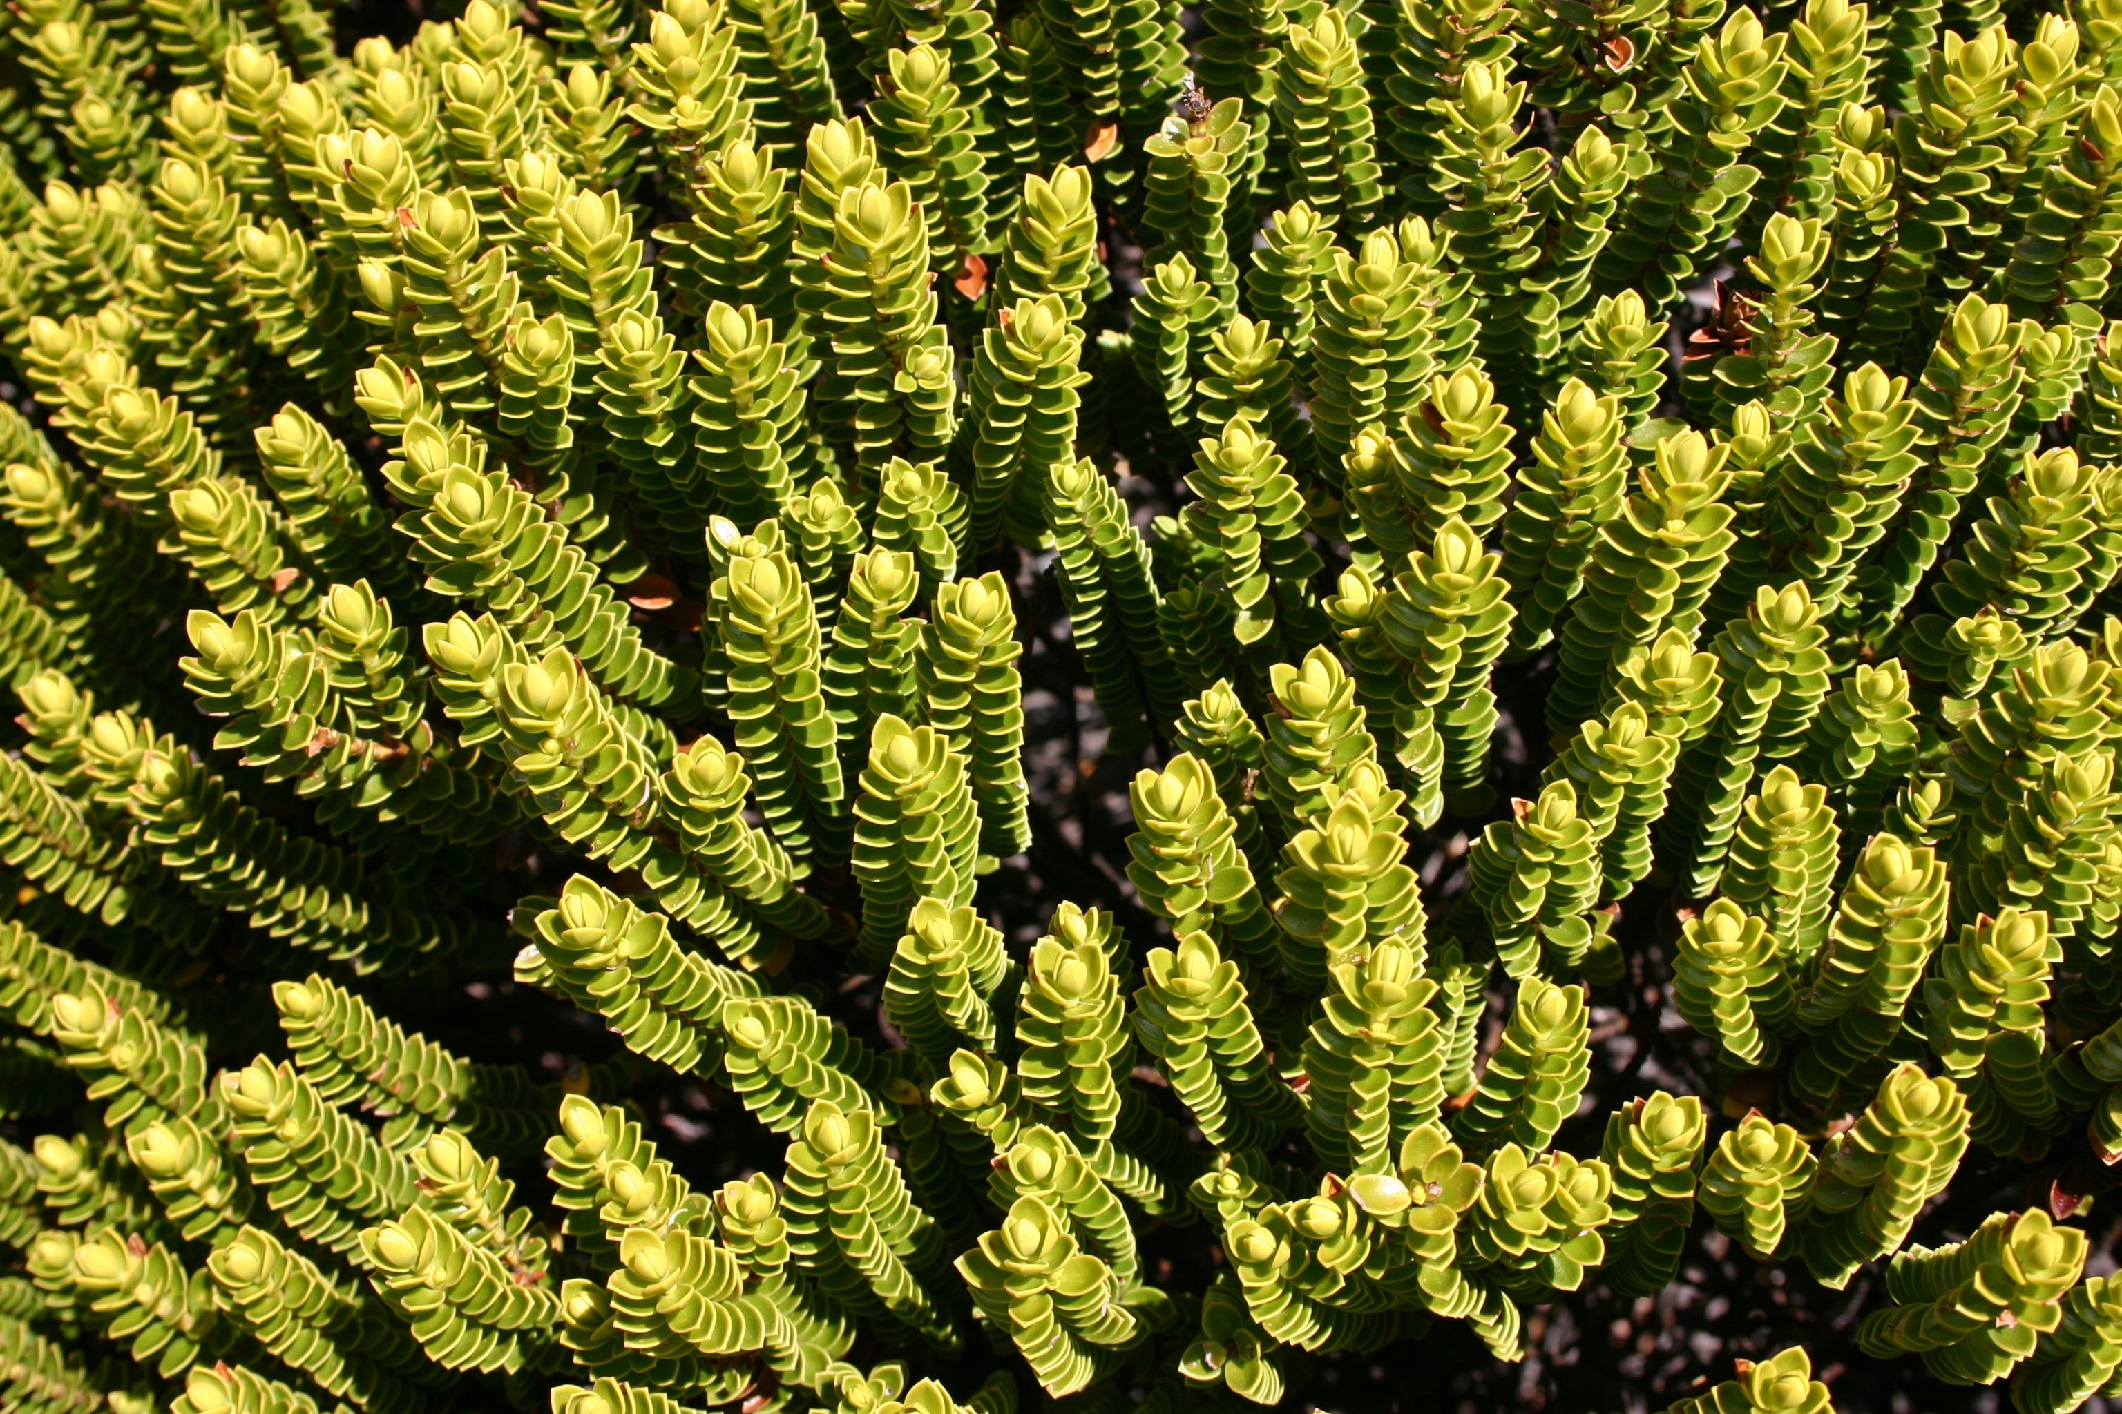
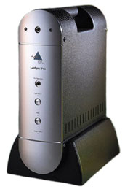
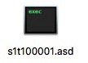
Data Flow Field Spectroscopy
Spectral Database
Data
Pre-
Processing
Data
Analysis
Radiance
Spectral data
Result
Instrument

Slide 12
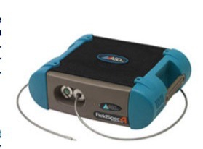
Recap: Ziel der Arbeit

Slide 13
Field Spectroradiometer Demo
Operating principles
Collecting spectra
Loading data into SPECCHIO
Spectral and metadata check

Slide 14
Data Flow Field Spectroscopy
Spectral Database
Data
Pre-
Processing
Data
Analysis
Radiance
Spectral data
Result
Instrument
Optional Work:
Develop a data storage in e.g. HDF5, where spectrometer data and additional metadata can be stored
These data can then be imported by a new file reader into the spectral database SPECCHIO
Metadata?

Slide 15




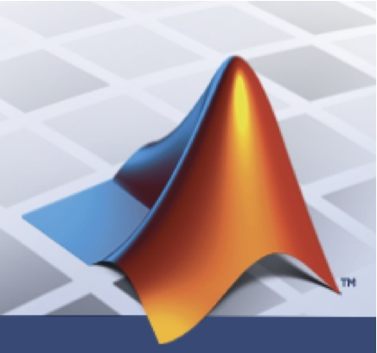



SPECCHIO Architecture
SPECCHIO Server
MySQL Database Server
Glassfish Application Server
& Web Server
User Workstation
Java VM (JRE 1.6)
SPECCHIO App
Pure Java
HTTPS Port
Port 3306
SPECCHIO
DB
Higher Level Languages
App
with SPECCHIO
Java
components
SPECCHIO uses a client-server architecture (RESTful). Data between client and server are Java objects encoded in XML. The data transfer can be encrypted (HTTPS) if required.

Slide 16
Questions
From my side:
Time schedule?
How many ASD spectrometers are needed for development and when are they required?
Poster presentation at Earsel SIG IS? http://www.earsel.org/SIG/IS/workshops/10-IS-Workshop/index.php

